Slide 1

Microservice Design Patterns: SAGA
Armine Hovhannisyan

Slide 2



Agenda
MS Design Patterns
What is SAGA
ACID Transactions
What is Data consistency and why its important
SAGA Implementation: Pros and Cons

Slide 3

MS design Patterns
Aggregator.
API Gateway.
Chained or Chain of Responsibility.
Asynchronous Messaging.
Database or Shared Data.
Event Sourcing.
Branch.
Command Query Responsibility Segregator
And…finally SAGA

Slide 4
What is SAGA
Segregated Access of Global Atomicity
The Saga design pattern is a way to manage data consistency across microservices in distributed transaction scenarios.
Saga is a sequence of transactions that updates each service and publishes a message or event to trigger the next transaction step.

Slide 5
ACID Transactions
Transaction should be ACID: Atomic Consistent Isolated Durable
Atomicity- each statement in a transaction (to read, write, update or delete data) is treated as a single unit. Either the entire statement is executed, or none of it is executed. This property prevents data loss and corruption from occurring if, for example, if your streaming data source fails mid-stream. Consistency - ensures that transactions only make changes to tables in predefined, predictable ways. Transactional consistency ensures that corruption or errors in your data do not create unintended consequences for the integrity of your table.
Isolation - when multiple users are reading and writing from the same table all at once, isolation of their transactions ensures that the concurrent transactions don’t interfere with or affect one another. Each request can occur as though they were occurring one by one, even though they're actually occurring simultaneously.
Durability - ensures that changes to your data made by successfully executed transactions will be saved, even in the event of system failure.

Slide 6
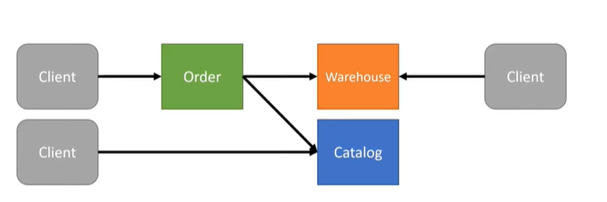
Data consistency
All data should be in valid state. Secure data from being changed by concurrent transactions. Based on business requirements inconsistency can allowed.
But there are cases when you should handle consistency otherwise the coast will be big. (mostly in e-commerce)
.

Slide 7
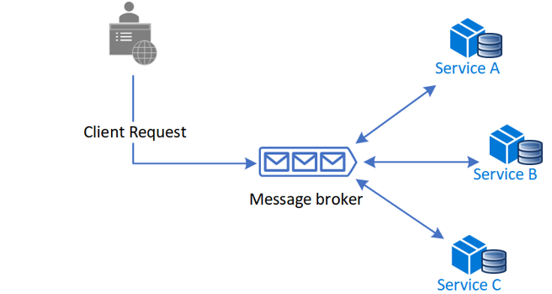
SAGA Implementations
Choreography It’s a way to coordinate sagas where participants exchange events without a centralized point of control. With choreography, each local transaction publishes domain events that trigger local transactions in other services.

Slide 8
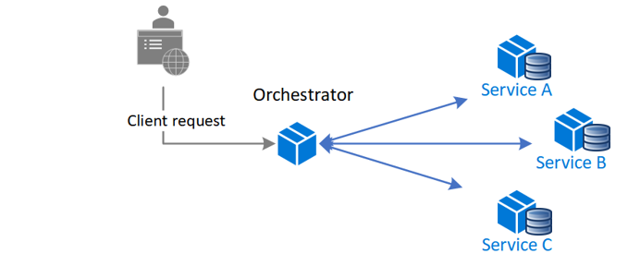
SAGA Implementations
Orchestration
Its a way to coordinate sagas where a centralized controller tells the saga participants what local transactions to execute. The saga orchestrator handles all the transactions and tells the participants which operation to perform based on events. The orchestrator executes saga requests, stores and interprets the states of each task, and handles failure recovery with compensating transactions.

Slide 9
Pros and Cons
Choreography
Orchestration
No single point of failure, since the responsibilities are distributed across the saga participants.
No additional service implementation and maintenance.
Risk of cyclic dependency between MS
Integration testing is difficult
No cyclical dependencies, because the orchestrator unilaterally depends on the saga participants.
Saga participants don't need to know about commands for other participants. Clear separation of concerns simplifies business logic.
Additional design complexity
Additional point of failure, because the orchestrator manages the complete workflow.

Slide 10


Thank You
Armine Hovhannisyan
Armine_Hovhannisyan@epam.com

